Slide 1
Instructions
Please get out a piece of paper and number it 1-36.
In this experiment, you will see a series of spliced faces. On each slide there will be two faces—a top face and a bottom face. Each face will be smiling on one half and neutral on the other half. Your task is to decide which face (the top or bottom) looks happier.
See the next slide for an example.

Slide 2


Which face looks happier—top or bottom?
Example

Slide 3
Instructions, continued
It may be difficult for you to determine which face you find happier. If you cannot decide, simply pick one. You must respond on every trial.
For each trial, write down your response (Top or Bottom) next to the corresponding number on your paper. If you have any questions, please ask them now.
Get ready to begin.

Slide 4
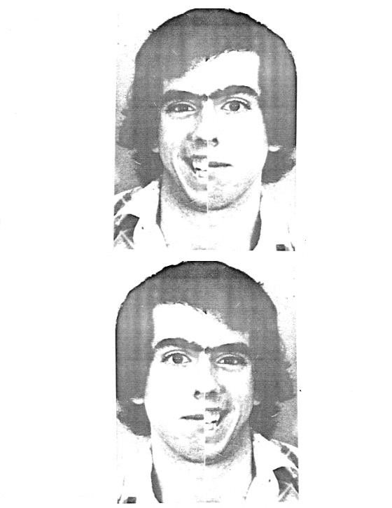
1

Slide 5
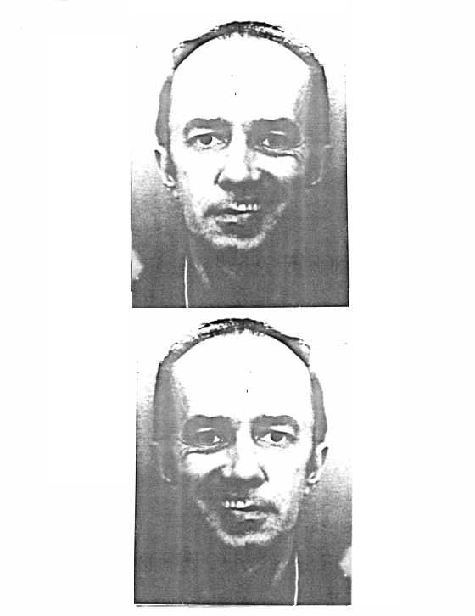
2

Slide 6
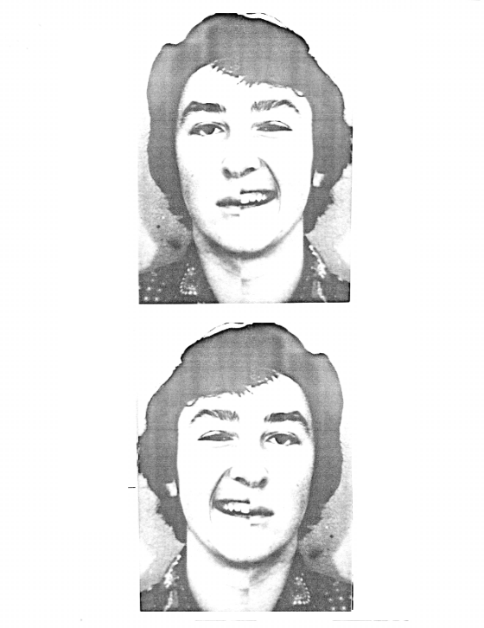
3

Slide 7
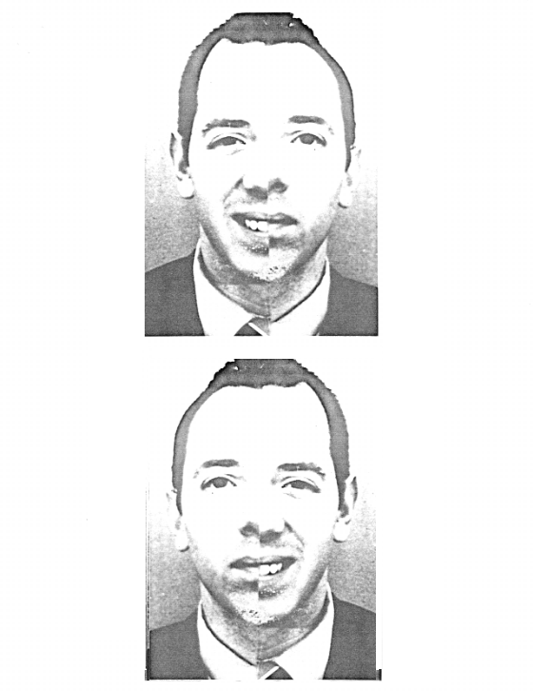
4

Slide 8
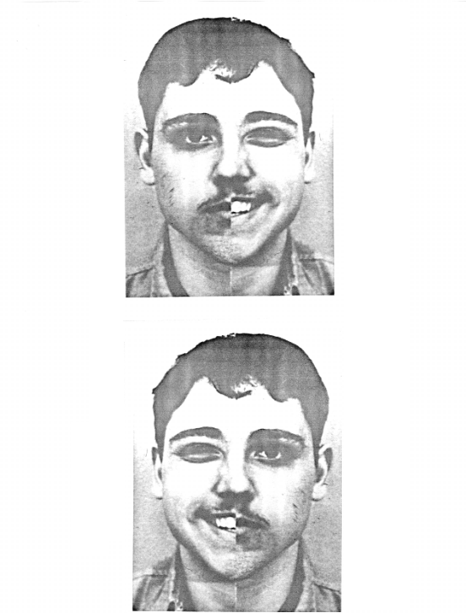
5

Slide 9
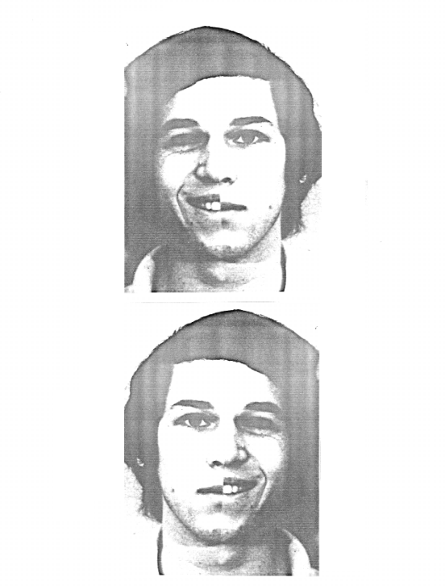
6

Slide 10
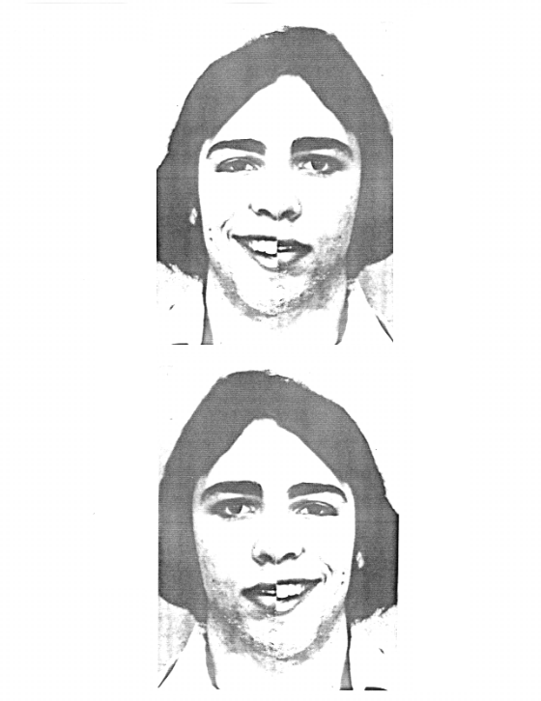
7

Slide 11
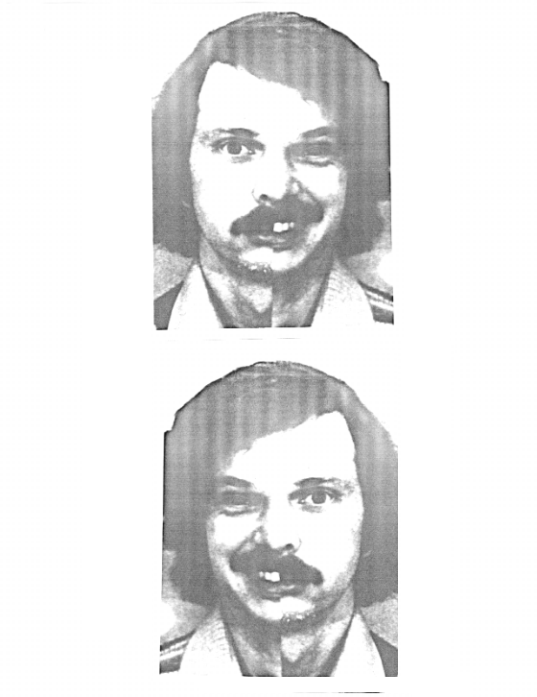
8

Slide 12
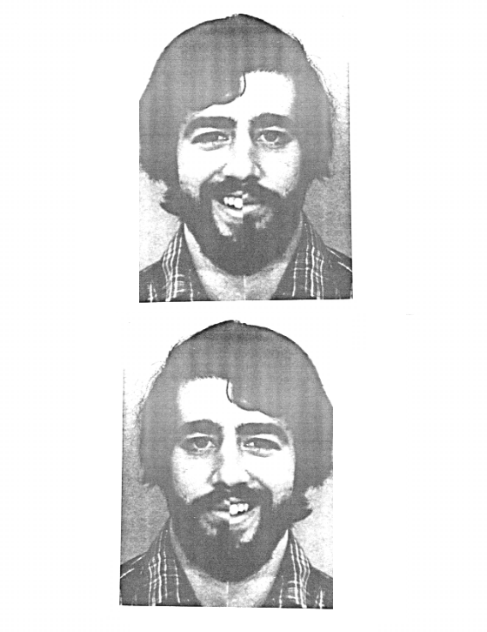
9

Slide 13
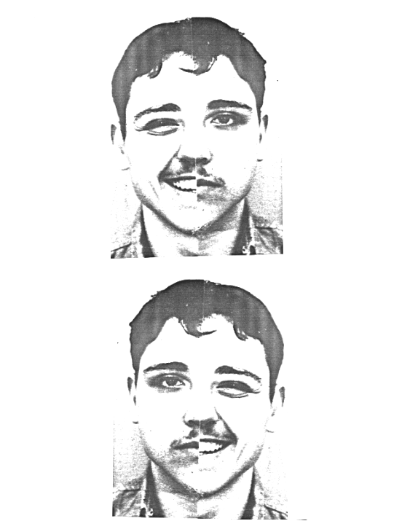
10

Slide 14
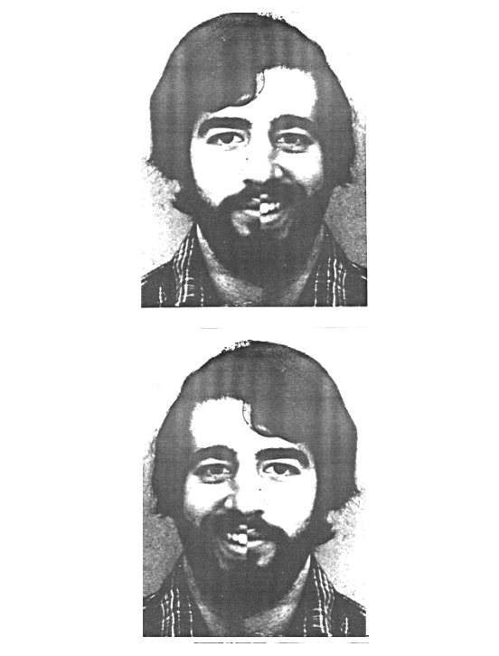
11

Slide 15
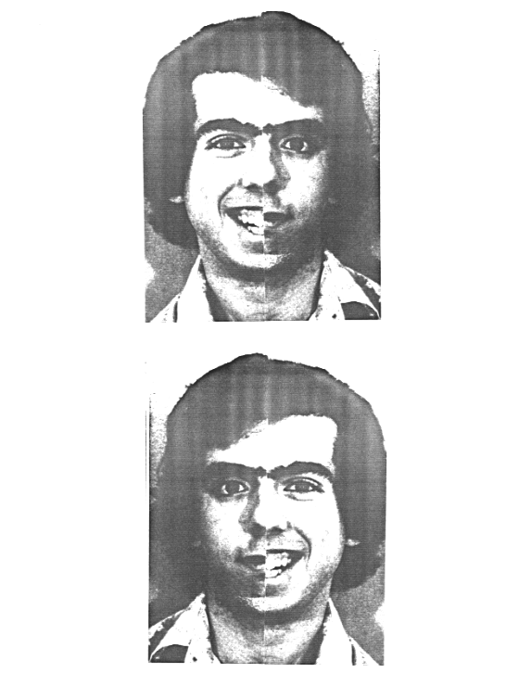
12

Slide 16
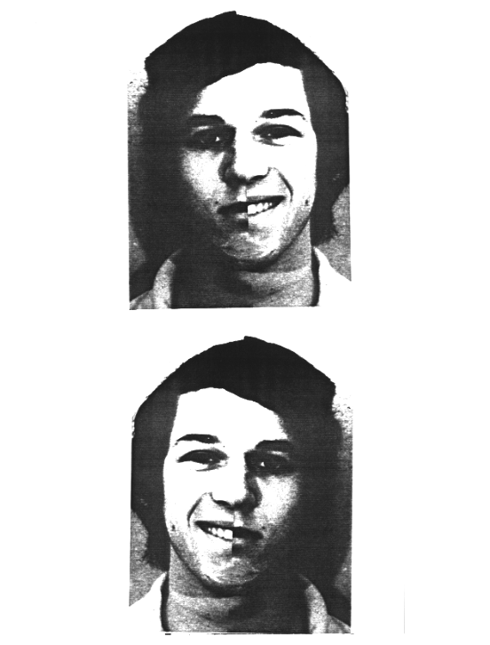
13

Slide 17
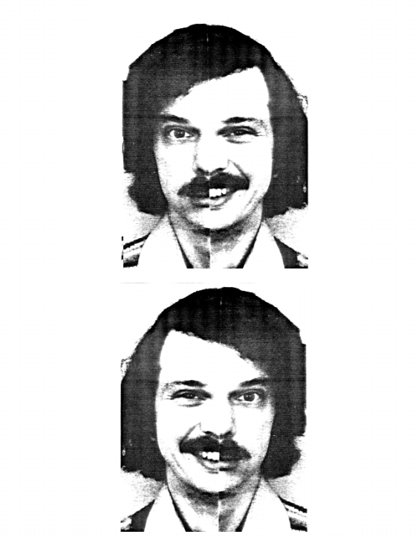
14

Slide 18
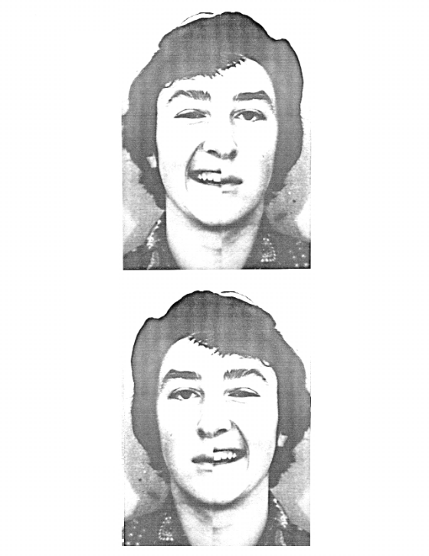
15

Slide 19
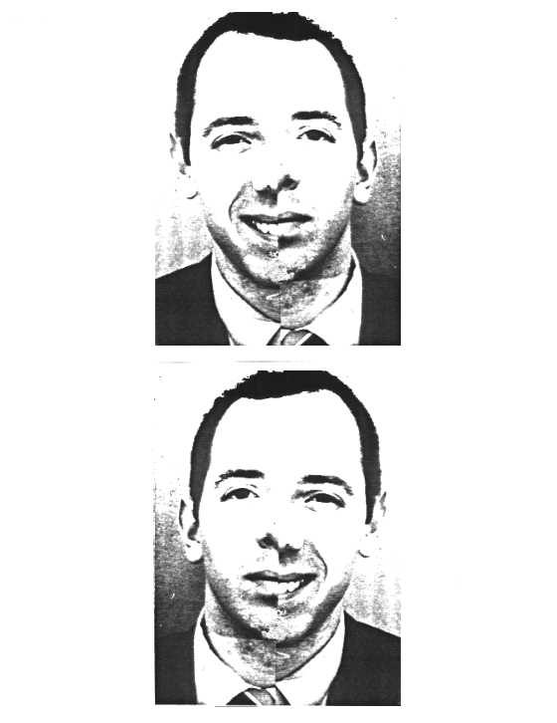
16

Slide 20
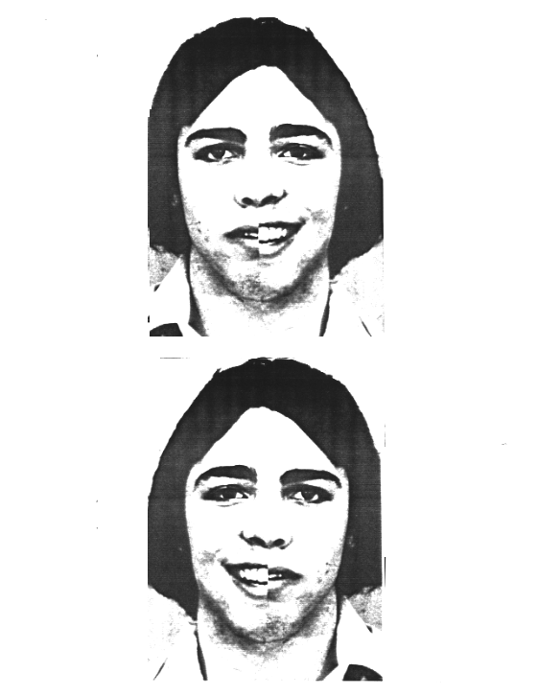
17

Slide 21
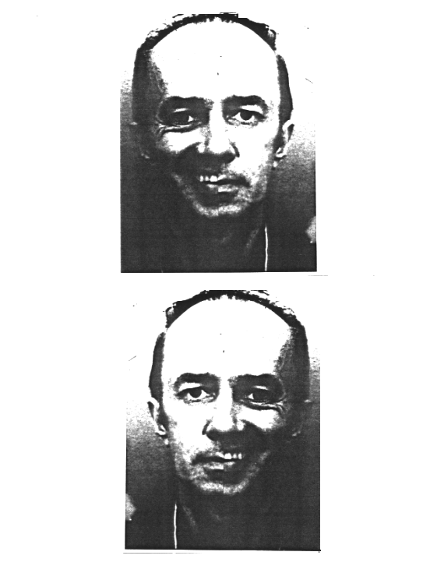
18

Slide 22
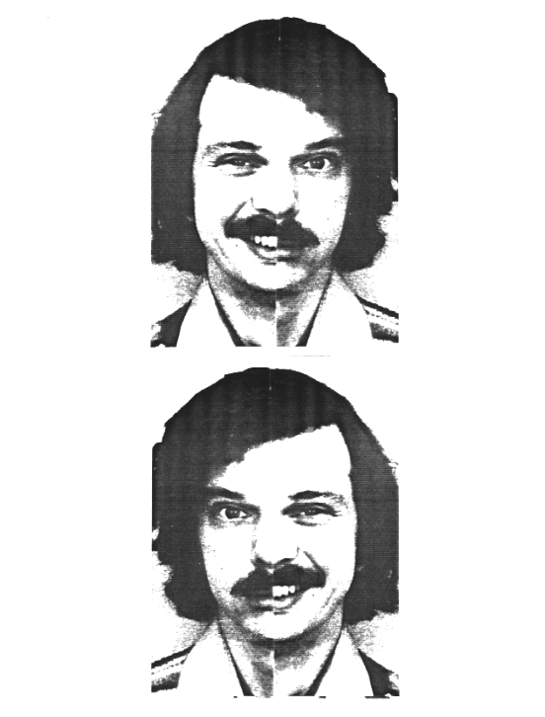
19

Slide 23
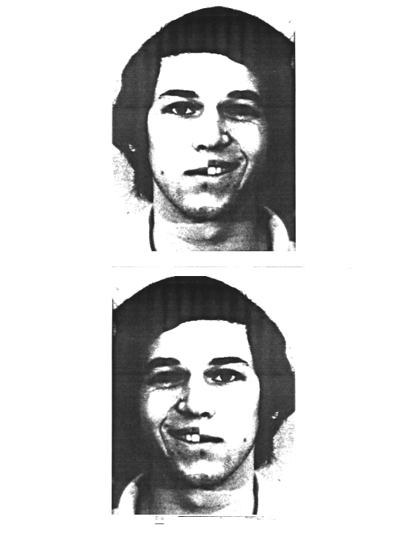
20

Slide 24
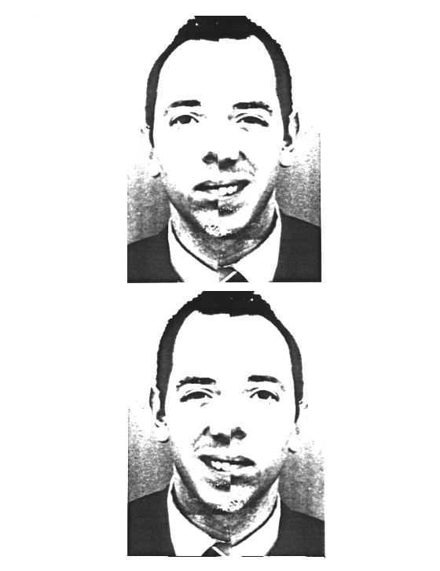
21

Slide 25
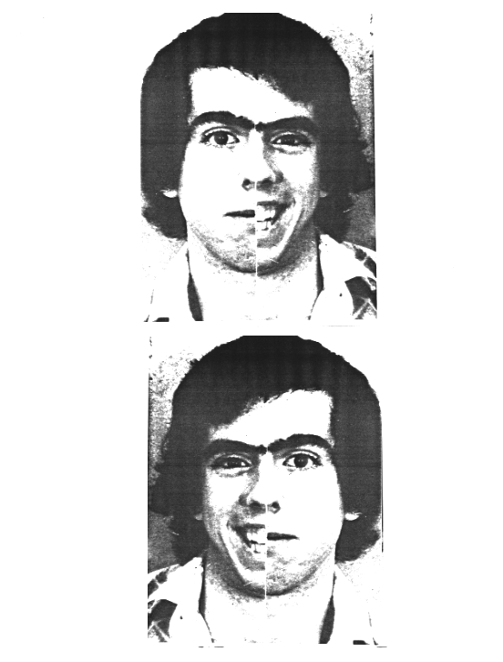
22

Slide 26
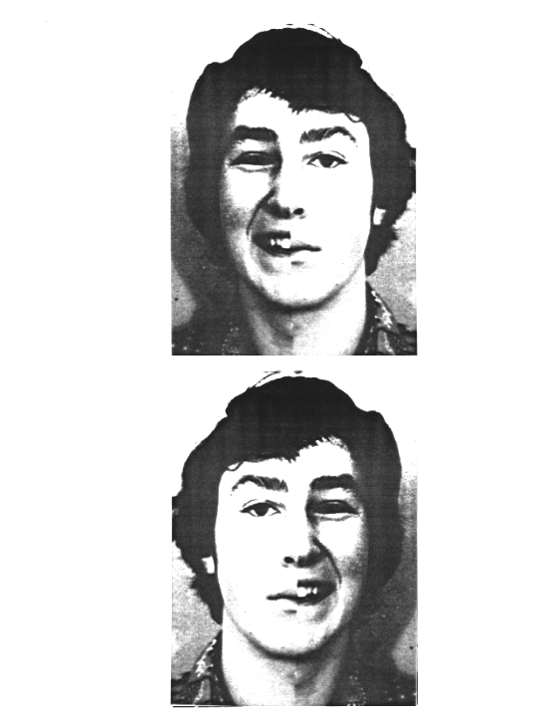
23

Slide 27
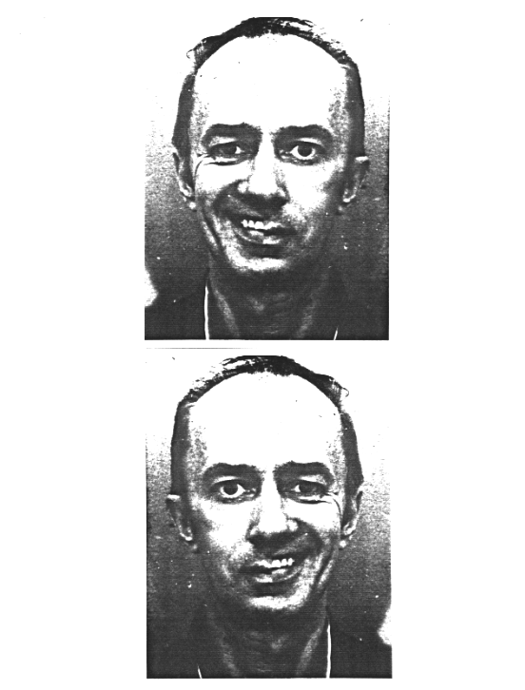
24

Slide 28
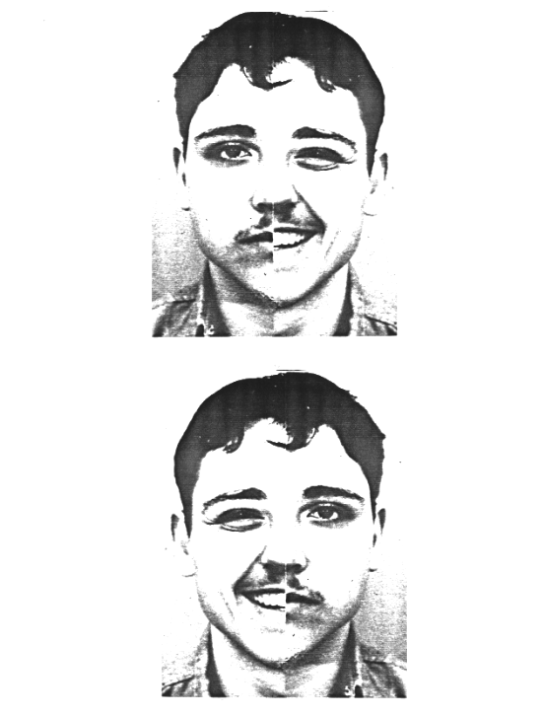
25

Slide 29
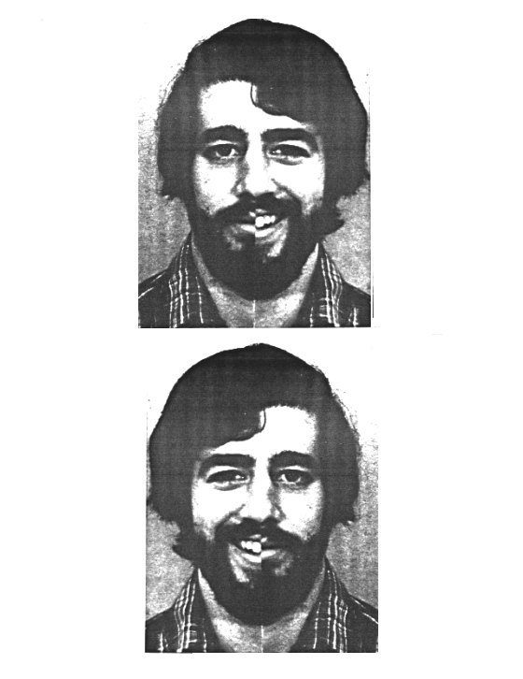
26

Slide 30
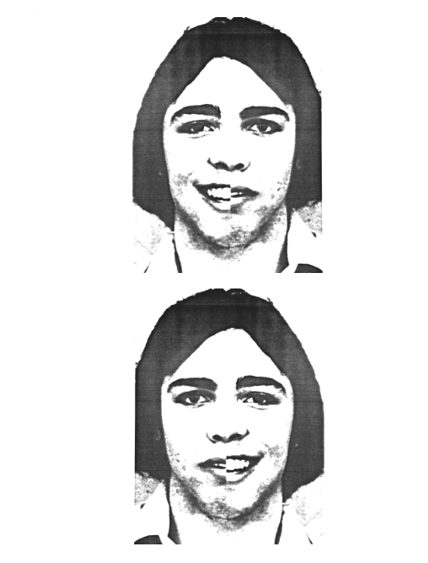
27

Slide 31
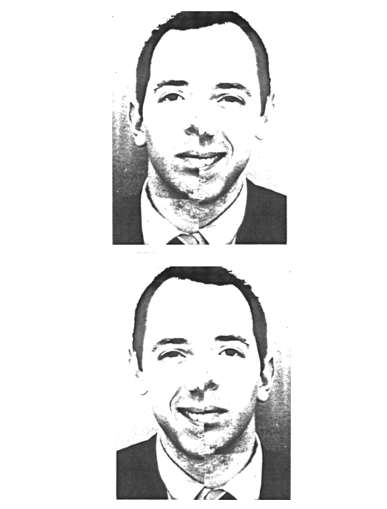
28

Slide 32
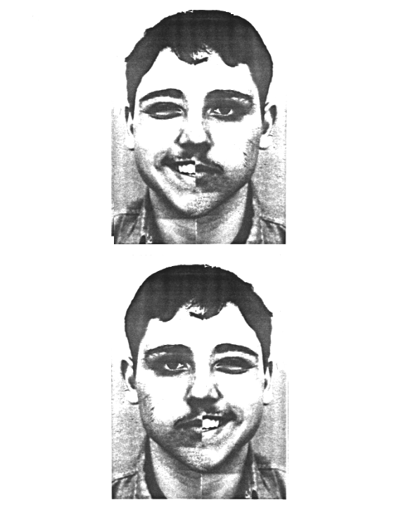
29

Slide 33
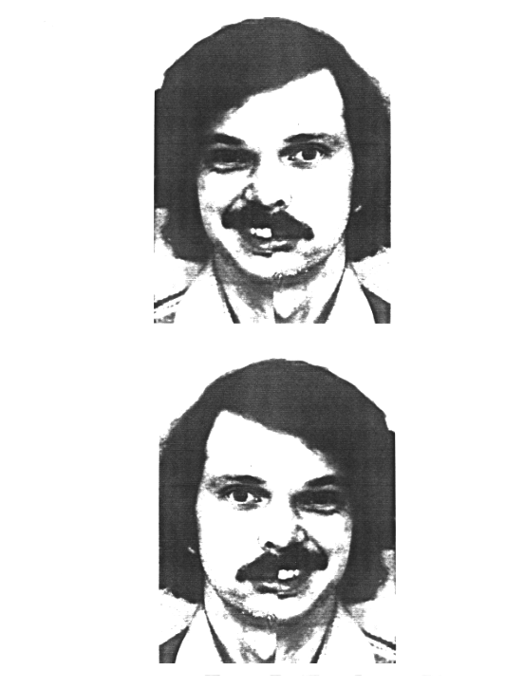
30

Slide 34
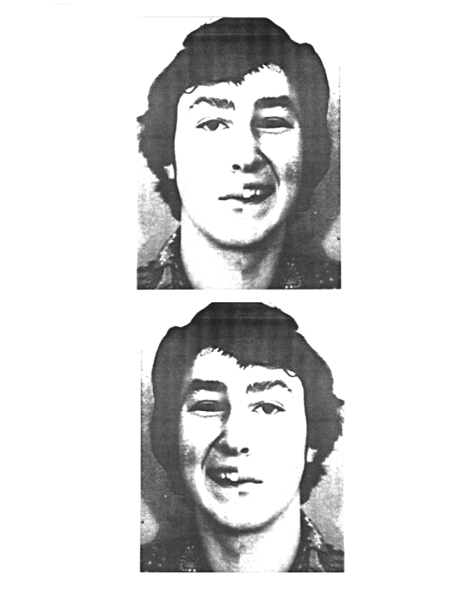
31

Slide 35
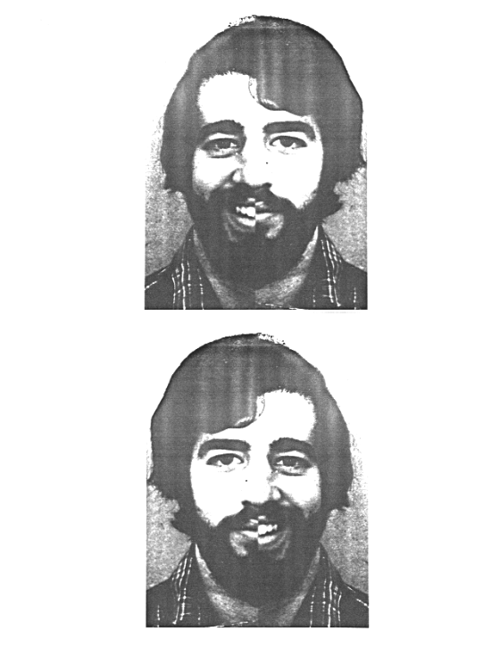
32

Slide 36
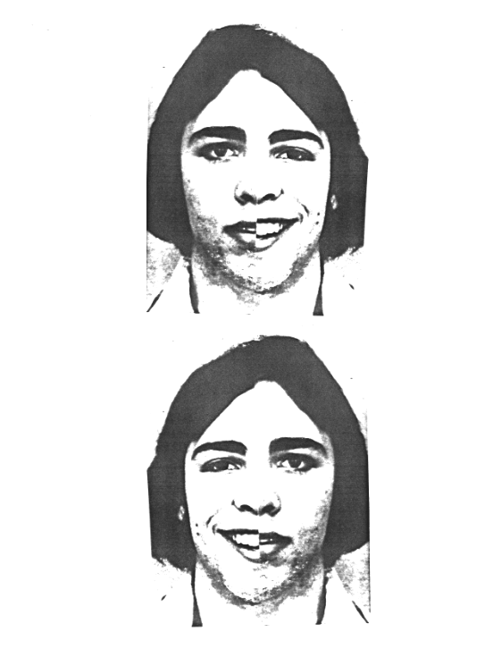
33

Slide 37
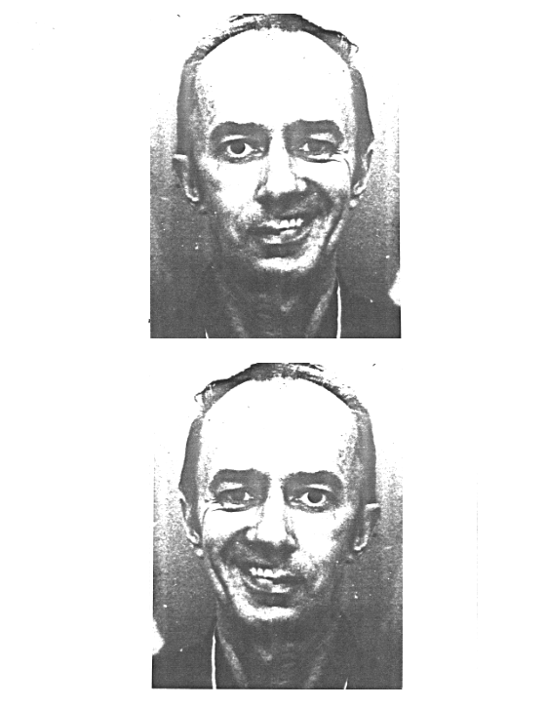
34

Slide 38
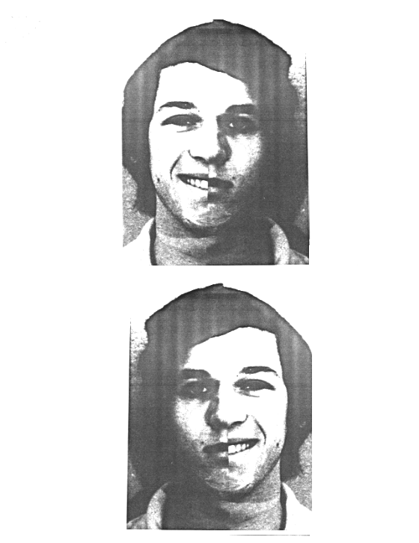
35

Slide 39
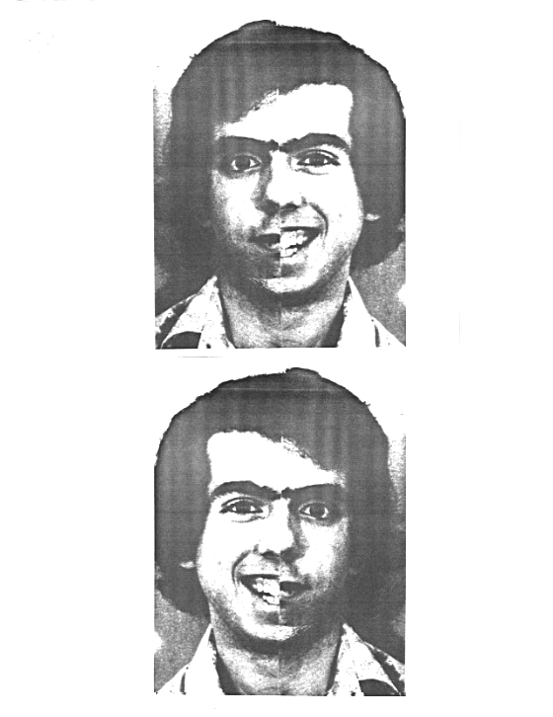
36

Slide 40
The experiment is over!
Thank you for participating.
Count the number of times you responded “Top” to the following trials:
2, 3, 5, 8, 11, 13, 14, 17, 20, 21, 22, 25, 26, 28, 31, 33, 34, 36
Now count the number of times you responded “Bottom” to the following trials:
1, 4, 6, 7, 9, 10, 12, 15, 16, 18, 19, 23, 24, 27, 29, 30, 32, 35
Add these totals together and call the sum “Right.”

Slide 41
Next, count the number of times you responded “Bottom” to the following trials:
2, 3, 5, 8, 11, 13, 14, 17, 20, 21, 22, 25, 26, 28, 31, 33, 34, 36
Finally, count the number of times you responded “Top” to the following trials:
1, 4, 6, 7, 9, 10, 12, 15, 16, 18, 19, 23, 24, 27, 29, 30, 32, 35
Add these totals together and call the sum “Left.”
*Make sure your Right and Left totals add up to 36.

Slide 42
Take the “Right” sum and subtract the “Left” sum. Divide the difference by 36. This is your Laterality Quotient (LQ).
(Right sum – Left sum) = LQ
36
*Your LQ may be negative.
When you have calculated your LQ, write it down on your paper. Next to it, indicate your gender and hand preference. Then hand your paper to the experimenter.
Thank you for participating!

Slide 43
Debrief
Replication of Levy, Heller, Banich, and Burton (1983)
  Chimeric faces: two picture halves combined
  Left half seen by Right Hemisphere (RH), right half seen by Left Hemisphere (LH)
Brain Asymmetry
  Lateralization of brains (i.e., differences between LH and RH)
  Non-brain damaged people

Slide 44
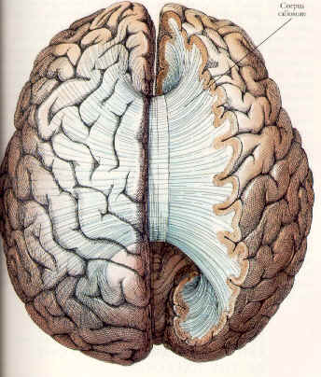
Left vs. Right Brain
Two separate hemispheres
Able to function independently
  Communicate via corpus callosum
Callosotomy
  Severing of corpus callosum
  Split-brain syndrome

Slide 45
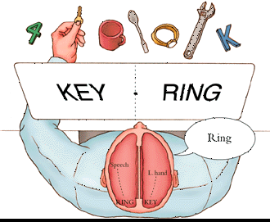
Split-Brain Experiments
“Key” to LH, “Right to RH
Report word
  Say “Ring” (language on LH)
  Pick Key with left hand (controlled by RH)

Slide 46
In Our Exp.
Evidence of lateralization
  One side seen as happier, younger, prettier, etc.
Lateralization Quotient (LQ)
  Negative: suggests RH face processing
  Positive: suggests LH face processing
  Zero: both hemispheres contribute

Slide 47
Caveats
Gender
  Effect stronger for males
Right-hand dominant
  75% show RH dominance in face processing
Left-hand dominant
  60% show RH dominance in face processing
  More likely to get positive LQ scores, or no strong lateralization
Reliability?
  Some variability
  Mostly stable

